Slide 1
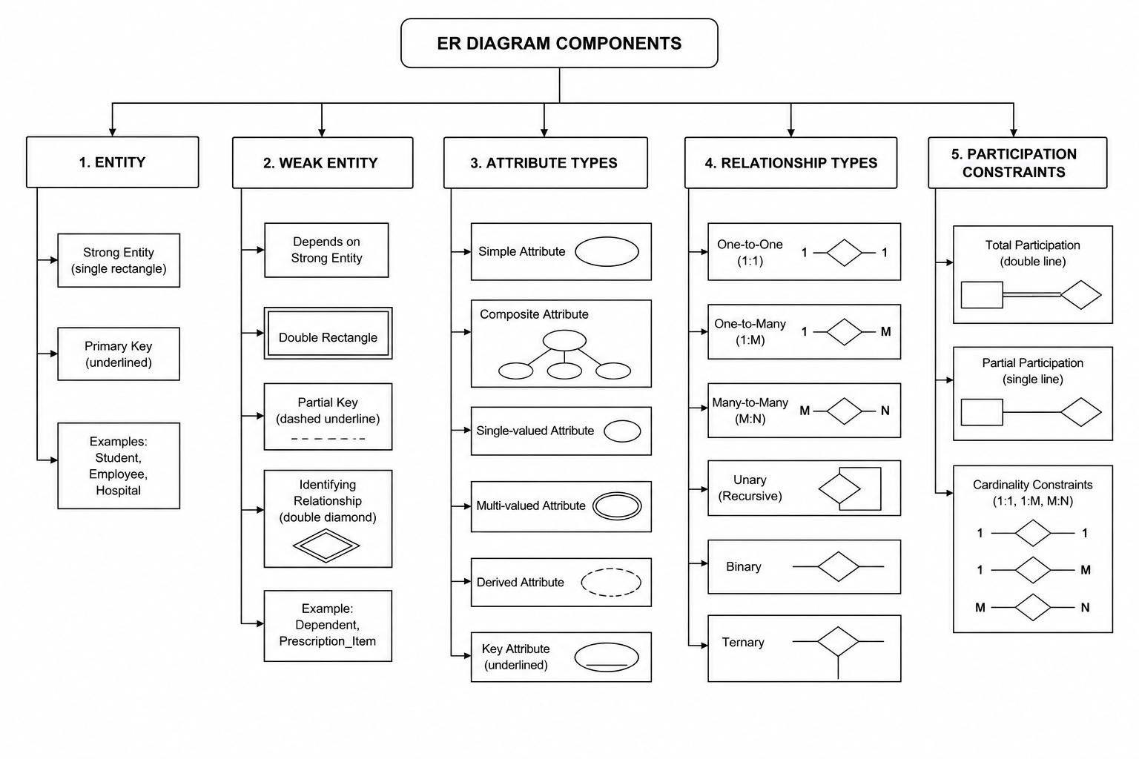
Concept map question - 4
Design a concept map for ER diagram components: entity, weak entity, attribute types, relationship types, and participation constraints.

